Slide 1

Intro to Bioinformatics
Workshop #2
SIGN IN HERE
Introduce yourself to those around you!
What college are in? What classes are you taking?

Slide 2
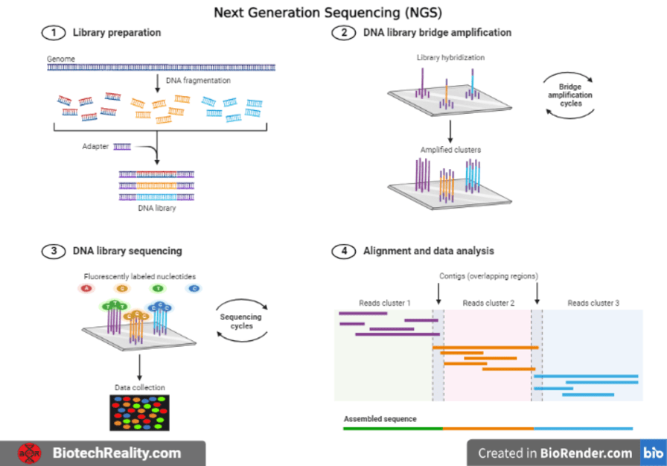
Next Generation Sequencing
Notes:
Extract DNA / RNA & fragment it
Add adaptors to the end of fragments, allowing them to bind to the sequencing platform later on
Fragment amplification via PCR
SBS - detect & record fluorescence emitted as each nucleotide is added to the DNA template strand
Assemble

Slide 3
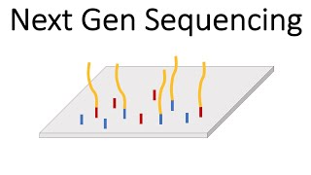
Illumina Sequencing

Slide 4
Notable Companies for NGS
Illumina
Short Read Data
PacBio
Long Read Data
Both
NGS Methods
Use fluorescent signals

Slide 5
Intro to Pandas Dataframe
In Google Colab!
(data.csv found here)

Slide 6
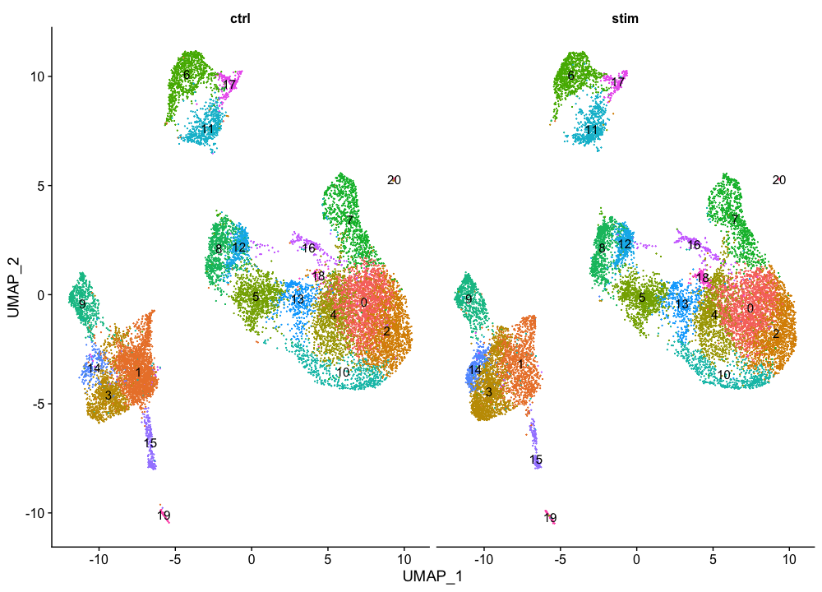
What is a UMAP plot?
https://hbctraining.github.io/scRNA-seq/lessons/08_SC_clustering_quality_control.html
Stands for Uniform Manifold Approximation and Projection
Gold standard way for researchers to visualize single cell data
Takes high dimensional dataset, and reduces it to low dimensional plot
As a cluster visualization method, helps researchers identify similarities between cells

Slide 7
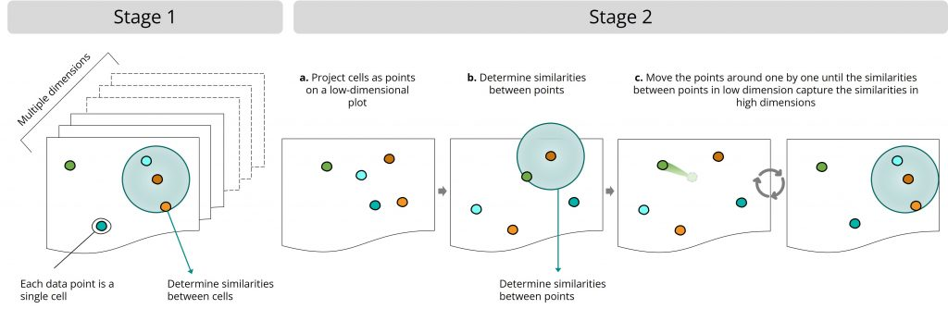
Steps in UMAP algorithm
https://www.scdiscoveries.com/blog/knowledge/what-is-a-umap-plot/
Stage 1:
The UMAP algorithm determines the similarities between cells in the original, high-dimensional dataset.

Slide 8
Steps in UMAP algorithm
https://www.scdiscoveries.com/blog/knowledge/what-is-a-umap-plot/
Stage 2a:
The UMAP algorithm projects the cells as points on a low-dimensional plot

Slide 9
Steps in UMAP algorithm
https://www.scdiscoveries.com/blog/knowledge/what-is-a-umap-plot/
Stage 2b:
The UMAP algorithm then determines the similarities between points in the low-dimensional dataset

Slide 10
Steps in UMAP algorithm
https://www.scdiscoveries.com/blog/knowledge/what-is-a-umap-plot/
Stage 2c:
The projected points are moved around until the similarities between points in the low-dimensional dataset resemble the similarities between cells in the original dataset

Slide 11
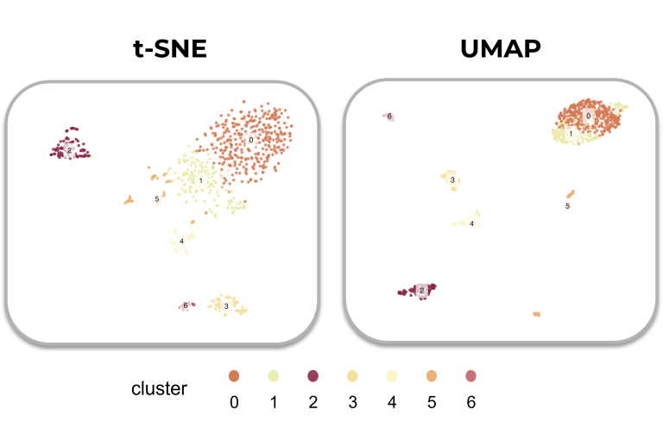
UMAP vs. t-SNE
https://www.scdiscoveries.com/blog/knowledge/what-is-a-umap-plot/
https://pair-code.github.io/understanding-umap/

Slide 12
UMAP Demo
https://www.kaggle.com/code/samuelcortinhas/intro-to-pca-t-sne-umap/notebook#t-SNE
https://colab.research.google.com/drive/1vR-l-7JVYP2gmMAFiKzXenlicMiIXY6x#scrollTo=TP2lZ3mH8jRw

Slide 13
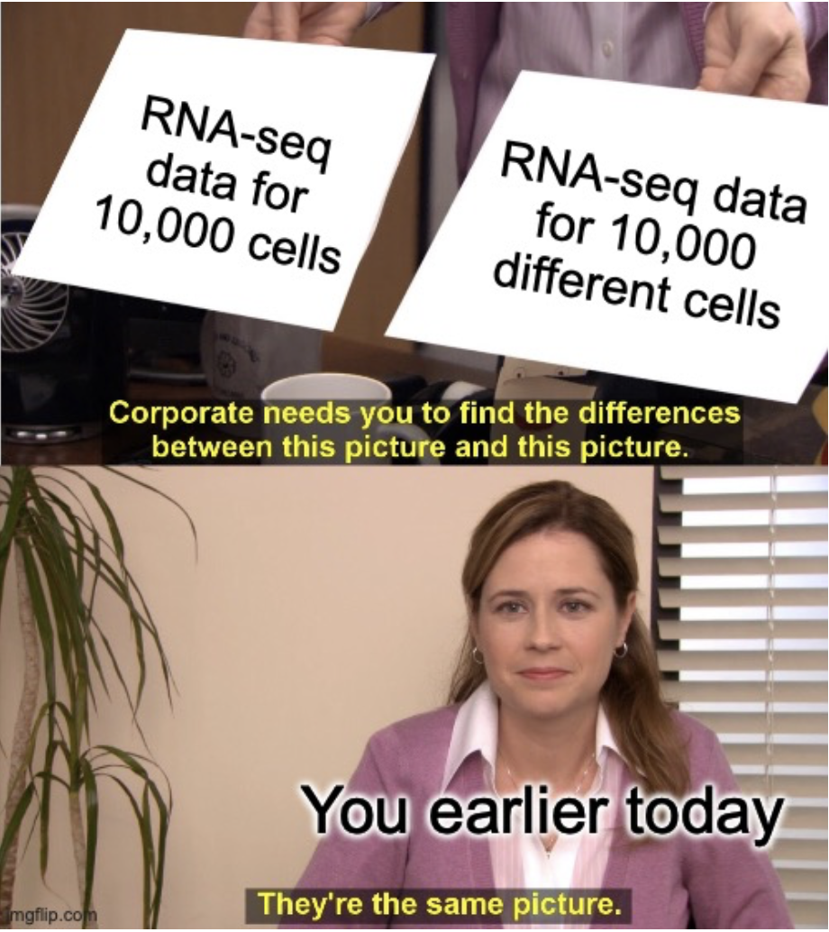
Differential Analysis

Slide 14
Differential Expression Analysis
Notebook for manual differential expression analysis.

Slide 15
Many tools can make these analysis trivial for those even without computational expertise
https://cellxgene.cziscience.com/

